Slide 1


Slide 2


Problem Solving - Skills and Techniques

Slide 3
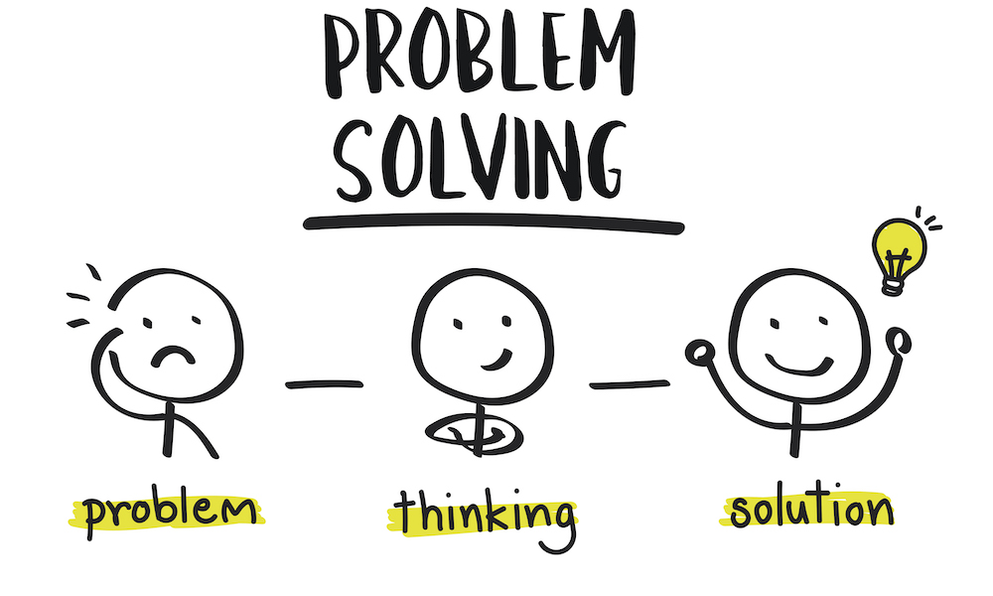
INTRODUCTION
What is Problem-Solving Skill?
Notes:
Problem-solving skills help you determine the source of a problem and find an effective solution. Although problem-solving is often identified as its own separate skill, there are other related skills that contribute to this ability.
Some key problem-solving skills include:
Active listening
Analysis
Research
Creativity
Communication
Dependability
Decision making
Team-building
Problem-solving skills are important in every career at every level. As a result, effective problem solving may also require industry or job-specific technical skills. For example, a registered nurse will need active listening and communication skills when interacting with patients but will also need effective technical knowledge related to diseases and medications. In many cases, a nurse will need to know when to consult a doctor regarding a patient’s medical needs as part of the solution.

Slide 4
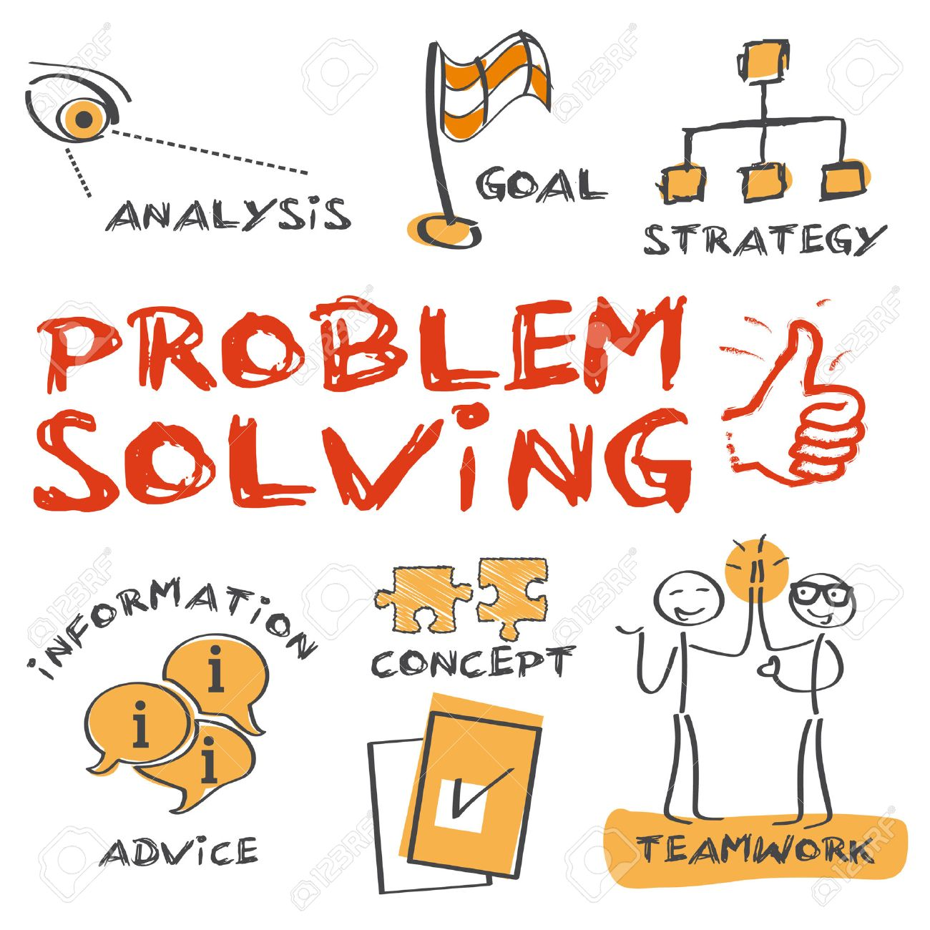
INTRODUCTION
Steps in Problem-Solving

Slide 5

INTRODUCTION
Define a Problem
Notes:
The first step to solving a problem is defining what the problem actually is – sounds simple, right? Well no. An effective problem solver will take the thoughts of everyone involved into account, but different people might have different ideas on what the root cause of the issue really is. It’s up to you to actively listen to everyone without bringing any of your own preconceived notions to the conversation. Learning to differentiate facts from opinion is an essential part of this process.
The same can be said of data. Depending on what the problem is, there will be varying amounts of information available that will help you work out what’s gone wrong. There should be at least some data involved in any problem, and it’s up to you to gather as much as possible and analyse it objectively.

Slide 6

CONCEPTS
List all the possible solutions
Notes:
Once you’ve identified what the real issue is, it’s time to think of solutions. Brainstorming as many solutions as possible will help you arrive at the best answer because you’ll be considering all potential options and scenarios. You should take everyone’s thoughts into account when you’re brainstorming these ideas, as well as all the insights you’ve gleaned from your data analysis. It also helps to seek input from others at this stage, as they may come up with solutions you haven’t thought of.
Depending on the type of problem, it can be useful to think of both short-term and long-term solutions, as some of your options may take a while to implement.

Slide 7

CONCEPTS
Evaluate the options
Notes:
Each option will have pros and cons, and it’s important you list all of these, as well as how each solution could impact key stakeholders. Once you’ve narrowed down your options to three or four, it’s often a good idea to go to other employees for feedback just in case you’ve missed something. You should also work out how each option ties in with the broader goals of the business.

Slide 8

CONCEPTS
Select an option
Notes:
Only now should you choose which solution you’re going to go with. What you decide should be whatever solves the problem most effectively while also taking the interests of everyone involved into account. There may be a way to merge two options together in order to satisfy more people.

Slide 9

CONCEPTS
Create an implementation plan
Notes:
At this point you might be thinking it’s time to sit back and relax – problem solved, right? There are actually two more steps involved if you want your problem solving method to be truly effective. The first is to create an implementation plan. After all, if you don’t carry out your solution effectively, you’re not really solving the problem at all.
Create an implementation plan on how you will put your solution into practice. One problem solving technique that many use here is to introduce a testing and feedback phase just to make sure the option you’ve selected really is the most viable. You’ll also want to include any changes to your solution that may occur in your implementation plan, as well as how you’ll monitor compliance and success.

Slide 10

CONCEPTS
Communicate your solution
Notes:
There’s one last step to consider as part of the problem solving methodology, and that’s communicating your solution. Without this crucial part of the process, how is anyone going to know what you’ve decided? Make sure you communicate your decision to all the people who might be impacted by it. Not everyone is going to be 100 per cent happy with it, so when you communicate you must give them context. Explain exactly why you’ve made that decision and how the pros mean it’s better than any of the other options you came up with.

Slide 11

CONCEPTS
Creative problem-solving techniques

Slide 12

CONCEPTS
Separate ideation from evaluation
Notes:
When you brainstorm creative ideas, have a separate time for writing it all down. Focus on generating lots of ideas. Don't prioritize or evaluate them until everything is captured.

Slide 13

CONCEPTS
Judging will shut it down
Notes:
Nothing stops the flow of creative ideas faster than judging them on the spot. Wait until the brainstorming is over before you evaluate.

Slide 14

CONCEPTS
Restate problems as questions.
Notes:
It's easier to entice a group into thinking of creative ideas when challenges are stated as open-ended questions.

Slide 15

CONCEPTS
Use "Yes and" to expand ideas.
Notes:
Here's one of the basic tenets of improv comedy. It's way too easy to shut down and negate ideas by using the word "but" (i.e. "But I think this is better..."). Avoid this at all costs. Instead, expand on what was previously introduced by saying "Yes, and..." to keep ideas flowing and evolving.

Slide 16

CONCEPTS
Essential Problem Solving Tools

Slide 17
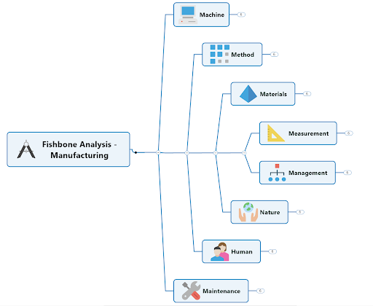
CONCEPTS
Fishbone diagrams
Notes:
Fishbone diagrams are a common problem solving tool so-named because, once complete, they resemble the skeleton of a fish.
With the possible root causes of an issue (the ribs) branching off from either side of a spine line attached to the head (the problem), dynamic fishbone diagrams let you:
Lay out a related set of possible reasons for an existing problem
Investigate each possibility by breaking it out into sub-causes
See how contributing factors relate to one another
Fishbone diagrams are also known as cause and effect or Ishikawa diagrams.

Slide 18
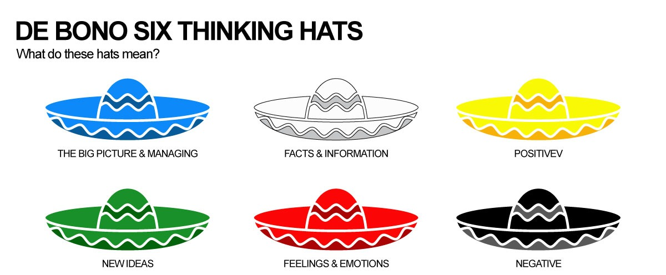
CONCEPTS
Notes:
In his book, Lateral Thinking for Management, De Bono introduced a directional sequence used in the brainstorming process. The Six Hats thinking method is based on a metaphorical six hats representing different human thinking types. The team uses these hats to address situations based on sequenced thoughts rather than chaotic discussions. The Six Hats thinking can be used during critical thinking sessions to achieve specific targets such as solving problems, discussing an argument, planning in-depth, and analysing the creative thinking process.
The Six Thinking Hats
Solving problems using the six thinking hats model requires looking at different thinking perspectives. Each perspective is represented with a hat colour. At the end of the discussion session, stakeholders should better understand the problem from other approaches to reach creative and innovative solutions. During each critical thinking discussion meeting, the facilitator determines which hat should be worn in a specific part of the discussion as follows:
White hat
This hat represents the facts and information about the problem of the argument. During this part, the stockholders only share information about the issue and take notes. No further development in the thinking process should be done. Questions in this part can be “what is the available information?” and “what are the facts we have?”
Yellow hat
In contrast to the black hat, the yellow hat supposes to reflect the sun or an optimistic attitude. The stakeholders think from an optimistic point of view about the problem or suggestion. It helps to spotlight the advantages and benefits of the recommendations. During this, the questions are “what are the advantages of applying the solution?” and “why do you think it is workable?”
Black hat
Wearing the black hat drives attendees to think about the problem or suggestion cautiously and defensively. This part aims to identify the cons of the proposal and the disadvantages, and why the idea may not work based on logical reasons.
Focusing on the warnings, risks or cautions helps the stakeholders to isolate the reasoning and think of the solutions in the yellow one. During this discussion, the question that can be asked is “what are the risks?” and “why is the suggestion not working?”
Red hat
The emotions hat presents the stakeholders’ feelings about the problem and their gut reactions. Using this hat is to understand the different emotional responses such as love, hate, like and dislike. The red hat does not aim to understand the reason behind these feelings. We can ask questions like “what do you feel about the suggestion?” and “what is your gut reaction?”
Green hat
This hat represents the creative thinking part of the discussion. During the critical thinking discussion, this hat fuels the stakeholders’ thinking to innovate a creative thinking solution for the problems or look to the suggestions from a creative perspective. Innovative tools can drive creativity during the conversations, such as the Lego Serious Play and brainstorming techniques.
Blue hat
This hat is the process control plan where the meeting leaders manage difficulties during the discussions. It makes sure that the guidelines of the six thinking hat technique is applied. This hat can be used to drive the thinking process to better routes. For example, the facilitators can direct the discussion to the green hat route if there are no ideas.

Slide 19
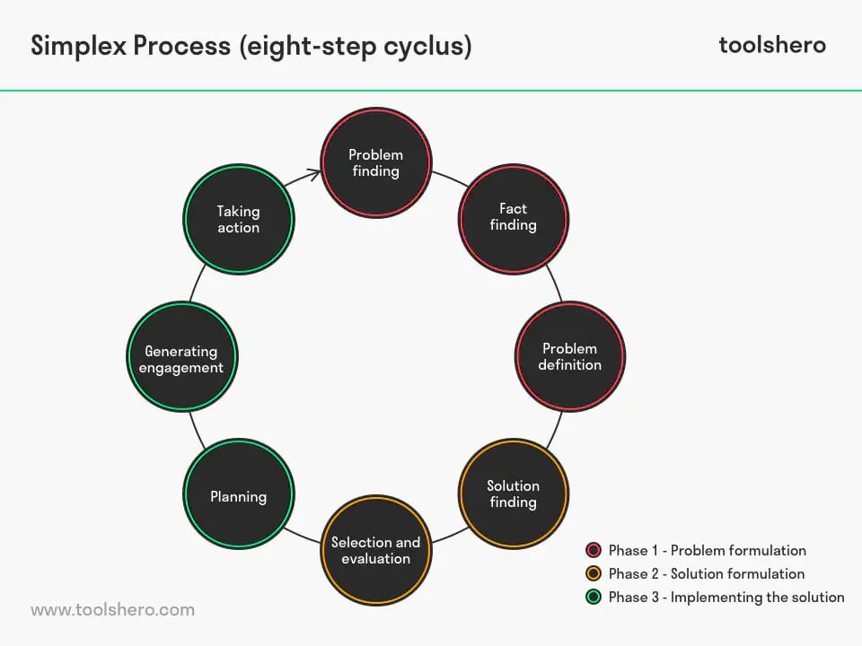
CONCEPTS
Simplex Process
Notes:
The Simplex Process is a simple, yet powerful method for solving problems and executing projects of any scale. The process, instead of being represented as a single, straight-line process is represented as a circle. This reminds us of the importance of continuous improvement, both to us and to our clients.
The Eight Steps
1. Problem Finding: Often the problem is obvious. But, sometimes the obvious problem we see addresses the symptoms and not the root cause. So, it’s helpful to stop before jumping into solution mode to ask some questions:
- what would our customers what us to improve?
- what could clients do better if we could help them?
- what’s failing in the process?
- ...
2, Fact Finding: What do I know about the issue?
- collect and analyze the data?
- how do different people see the problem?
- what solutions have been tried?
- what would be the benefits?
- ...
3. Problem Definition: Now that you understand the problem area, you can define the specific issue you are going to address. You need to get the issue bounded appropriately. Too broad and you’ll not have either the time or the resources to address the issue effectively. Too narrow and you may only address the symptoms. Basadur suggests asking “Why?” to explore broadening a question and “What’s stopping you?” to narrow one.
4. Idea Finding: Here you generate problem solving ideas. Talk with your team and your colleagues. Use focus groups or brain storming. This is a step of generating ideas, not of analyzing or critiquing them.
5. Evaluation and Selection: In this step, you evaluate the ideas that have been developed and choose one to take forward. That choice might be very obvious. If not, you evaluate the options:
- is the option consistent with the desired future state and strategies being pursued
- what will be the impact of the solution
- what will be the cost of the solution
- does the benefit justify the cost
- ...
6. Planning: Once you’ve made a choice, it’s time to plan the implementation. For solving small problems or executing small projects, a set of action steps, like the IT Leaders Program uses for setting personal goals, may be adequate. Larger problems or projects will benefit from using a more formal project management approach.
7. Sell the Idea: If you have not already done so, now is the time to let the stakeholders associated with your idea in or what you and your team are up to. (This may be an appropriate time to flip back to the pages in your Leaders Program workbook to the discussion there about stakeholder communication. Since larger solutions will involve culture, internal politics, and change, you may want to scan those topics as well.)
8. Action: Now that you have finished your preparation, it’s time to get to work on the solution. Here’s where the careful thinking and planning pays off with a faster, less eventful solution.

Slide 20
EXAMPLE 1
Give me an example of a problem you have faced in the past, either as part of a team or as an individual. How did you solve the problem?

Slide 21
EXAMPLE 2
Employers may base problem-solving questions around three main areas:
How you have approached situations in the past
How you would manage a problem that would arise as part of the job
How you handle problems throughout the application process

Slide 22







/ethnuscodemithra
Ethnus Codemithra
/ethnus
/code_mithra
THANK YOU
https://learn.codemithra.com/
codemithra@ethnus.com
+91 7815 095 095
+91 9019 921 340

